Slide 1
CAQH CORE Webinar
State Medicaid Experiences with Value-based Payments with Center for Health Care Strategies and Minnesota Medicaid
June 6, 2019

Slide 2
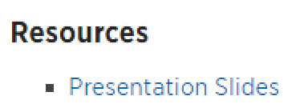

Logistics
Presentation Slides and How to Participate in Today’s Session
You can download the presentation slides at www.caqh.org/core/events after the webinar.
Click on the listing for today’s event, then scroll to the bottom to find the Resources section for a PDF version of the presentation slides.
A copy of the slides and the webinar recording will be emailed to all attendees and registrants in the next 1-2 business days.
Questions can be submitted at any time using the Questions panel on the GoToWebinar dashboard.

Slide 3
Session Outline
Overview of CAQH CORE VBP Report
Overview of State Medicaid Agency Trends in Value Based Payment
Integrated Health Partnerships: A Collaboration between Payer and Provider
Q & A

Slide 4
Thank You to Our Speakers
Tricia McGinnis
Senior Vice President
Center for Health Care Strategies
Mathew Spaan
Manager, Care Delivery & Payment Reform
Department of Human Services
Lina Gebremariam
Manager
CAQH CORE

Slide 5

CAQH CORE
Value-Based Payments Overview
Lina Gebremariam
CAQH CORE Manager

Slide 6
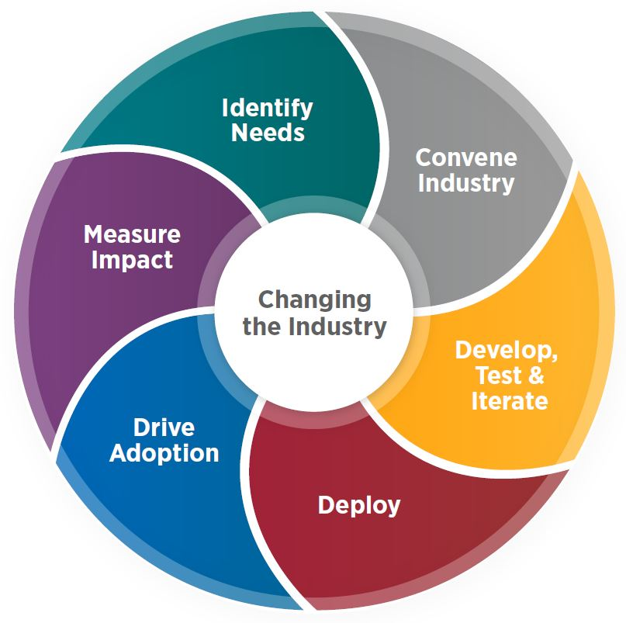
CAQH CORE Mission and Vision
MISSION
Drive the creation and adoption of healthcare operating rules that support standards, accelerate interoperability and align administrative and clinical activities among providers, payers and consumers.
VISION
An industry-wide facilitator of a trusted, simple and sustainable healthcare data exchange that evolves and aligns with market needs.
DESIGNATION
Named by Secretary of HHS to be national author for operating rules mandated by Section 1104 of the Affordable Care Act.
BOARD
Multi-stakeholder. Members include health plans, providers (some of which are appointed by associations such as the AHA, AMA, MGMA), vendors, and government entities. Advisors to the Board include SDOs.

Slide 7





Streamlining Adoption of Value-Based Payments
Data Quality & Uniformity: Standardize identifiers, data elements, transactions and code sets.
Interoperability: Define common process and technical expectations.
4
Value-based Payment Opportunity Areas
Quality Measurement: Educate on need for consistent and actionable quality data while considering physician burden.
Patient Risk Stratification: Promote collaboration and transparency of risk stratification models.
Provider Attribution: Improve provider awareness of patient attribution and transparency in underlying models.
CAQH CORE Vision
A common infrastructure that drives adoption of value-based payment models by reducing administrative burden, improving information exchange and enhancing transparency.
CAQH CORE Report
Identified five opportunity areas in the industry that could smooth the implementation of value-based payments and prevent variation across the industry.
Project Status
CAQH CORE VBP Advisory Group identified five operating rule opportunity areas for the CAQH CORE Participants to pursue – rule development activity to begin in Q3 2019.
7

Slide 8
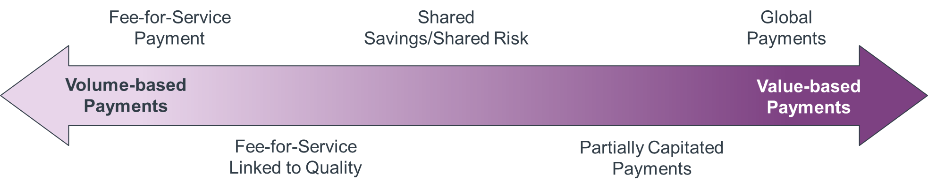
Continuum of Value-based Payment Models
CAQH CORE Opportunity Areas Have Direct Impact
1
Data Quality & Standardization .
2
Interoperability .
3
Patient Risk Stratification .
4
Provider Attribution .
5
Quality Measurement .
8

Slide 9
Growth in ACOs Across Payers
Covered Lives
Source: https://www.healthaffairs.org/do/10.1377/hblog20170628.060719/full/.
Not for public distribution.
9

Slide 10
Overview of State Medicaid Agency Trends in Value Based Payment
CAQH CORE National Webinar
June 6, 2019
Tricia McGinnis, Senior Vice President

Slide 11
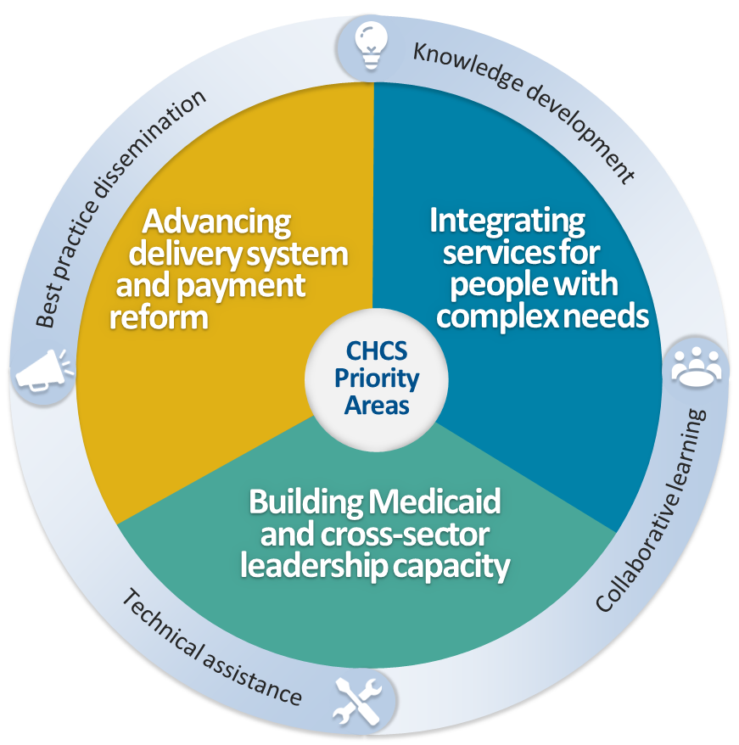
About the Center for Health Care Strategies
A nonprofit
policy center dedicated to improving
the health of
low-income Americans
Notes:
CHCS was established in 1995 through a major grant from the Robert Wood Johnson foundation to improve the underpinnings of the nation’s health care safety net.
Today, the mission of the Center for Health Care Strategies (CHCS) is to support innovations in care delivery and improve the health of low-income Americans, particularly individuals with complex and high-cost needs.
To achieve its mission, CHCS’ work with states, health plans, providers, community-based organizations, and federal policymakers focuses on three priorities:
Integrating services for people with complex needs;
Advancing delivery system and payment reform; and
Building Medicaid and cross-sector leadership capacitiy
CHCS’ activities fall under the following broad buckets:
Knowledge development;
Collaborative learning;
Technical assistance; and
Best practice dissemination.

Slide 12
Key Cost Drivers in Medicaid
Poorly managed care for patients with complex care needs, including severe mental health issues, substance use disorders, and chronic conditions
Facility costs for patients with long term support and services needs, including developmental disabilities and physical limitations
Frequent and avoidable emergency room use
Select high cost drugs (e.g., Sovaldi)

Slide 13
Key Levers for Addressing Medicaid Costs
Value based payment and purchasing (VBP)
Coverage and access to lower cost alternatives
  Medication assisted therapy
  Home and community based services
Provider infrastructure and capacity building

Slide 14
What drives Medicaid VBP Approaches?
State budget constraints
Federal funding and regulations
Health improvement priorities
Provider uptake of Medicare models

Slide 15






The Four Most Common Medicaid VBP Approaches
Per member per month
(40 states)
Bundled
Payments
(13 states)
ACO Shared Savings/Risk
(12 states)
Capitation/
Global Payments (8 states)
Notes:
The following slides give some examples and evidence for each of the four most common VBP approaches, from several different states, mostly within Medicaid.
P4P ties provider payment directly to specific indicators of quality or efficiency
Clinical Episode Payment: A bundled payment for a set of services that occur overtime and across settings
Shared savings: Providers that succeed in keeping costs below a total cost of care benchmark keep a percentage of the savings
Capitated payment: Providers receive an upfront per member per month (PMPM) payment to cover a wide range of services

Slide 16
Medical Homes and Health Homes
Patient-Centered Medical Homes (PCMH)
  PCMH recognition from National Committee for Quality Assurance (NCQA or state-defined programs
  Typically paid a per-member-per-month (PMPM) rate, sometimes tiered based on type of PCMH and its capabilities
  Many states beginning to combine PCMH with shared savings models
Medicaid Health Homes
  Established for Medicaid under the Affordable Care Act
  Focused on patients with multiple complex physical and mental health conditions
  Six services, including care management and coordination and referral to community and social support services
  Typically paid a PMPM rate substantially higher than PCMH

Slide 17
Bundled Payments: Arkansas
Retrospective Episodes of Care for 17
conditions:
  Medicaid outcomes by episode bundle:
    Knee/hip replacement: Average episode cost fell 4%
    Chronic obstructive pulmonary disease (COPD): Average episode cost fell 8%
    Perinatal: C-section rate reduced by 7 percentage points
    Asthma: Number of providers in ‘unacceptable’ cost category reduced from 17 to 6
    Increased follow-up visit rates, some quality improvements
  Journal of Health Economics 2018 study* on perinatal episode (across payers, not just Medicaid)
    Spending per episode decreased 3.8%
    80% of savings due to changes in inpatient care price, rather than quantity
    Reductions in C-section rates and inpatient stays not statistically significant
Notes:
Outcomes:
State Evaluation - Summary of Medicaid outcomes
http://www.achi.net/Content/Documents/ResourceRenderer.ashx?ID=482, page 9
NBER study
For the overall (not just Medicaid) 3.8% drop in perinatal spending, this came from NBER study comparing AR data before and after implementation to peer states without episodes of care.
More than 80% of the reduction in perinatal spending came from a reduction in spending on inpatient facility care. This was driven by changes in price rather than quantity.
Declines in physician spending and outpatient spending were small and statistically insignificant, as were changes in utilization, including caesarean section rates and the length of inpatient stays. In terms of quality measures, EBP implementation was associated with improvements in chlamydia screening rates but no other changes.
More information:
Statewide Tracking Report (May 2017): http://www.achi.net/Content/Documents/ResourceRenderer.ashx?ID=482
Detailed quality outcomes beginning on page 26.
Summary of National Bureau of Economic Research Study on Perinatal Episode: http://www.nber.org/aginghealth/2018no1/w23926.shtml

Slide 18
Shared Savings/Risk: Massachusetts
MassHealth Accountable Care Organizations
  Participate in one of three Medicaid Models
    Primary Care ACO (FFS, with shared savings/losses)
    MCO-Administered ACO (FFS, with shared savings/losses)
    Partnership Plan (PMPM)
  Payment dependent on:
    Cost performance: Risk-adjusted Total Cost of Care Benchmark
    Quality performance: ACO Quality Measure Slate
  Collaborate with “Community Partners” (Behavioral Health & Long Term Services and Supports)
  Will provide “flexible services” to address social needs
Notes:
The Massachusetts Medicaid program, MassHealth, introduced accountable care organizations (ACOs) for many of its members in March 2018.
Accountable Care Partnership Plan - Provider-led ACO partnered with a single MCO.
Primary Care ACO - Provider-led ACO contracting directly with MassHealth
MCO-Administered ACO - Provider-led ACO contracting with one or more MCOs.

Slide 19
All Payer Global Budget for Hospitals:
Maryland
In 2014, implemented per member per month
global budgets for hospitals across Medicaid, Medicare, and commercial payers
CMMI agreement requirements: | Results:
Hospital spending growth below 3.58% per year | Average annual hospital spending growth 1.53% per year
$330M Medicare savings over 5 years | $586M in Medicare savings in first 3 years
Reduce Medicare 30-day readmission rate to at or below national average over 5 years | No statistically significant change in readmission rate in first 3 years, vs. comparison group
Reduce rate of hospital-acquired conditions by 30% | Hospital-acquired conditions reduced by 44% through 2016
MD Dept. of Health All-Payer Hospital Model Results Performance Year 3, March 2018: http://www.hscrc.state.md.us/Documents/Modernization/Maryland%20APM%20Performance%20Report%20-CY2016_3_9_18.pdf
Notes:
Results
Hospitals adapted quickly to the new system, with 95% of payments away from FFS in the first year of the program – far exceeding the original goal.
For MD hospitals, it made more sense from a business perspective to avoid uncertainty and quickly transition away from FFS. The quick adaptation may have something to do with Maryland’s long history of rate-setting.
The state also exceeded its 5-year savings goal, with $586M in Medicare hospital savings in the first three years.
More Information:
RTI/CMS evaluation:
https://downloads.cms.gov/files/cmmi/md-all-payer-thirdannrpt.pdf
State evaluation:
http://www.hscrc.state.md.us/Documents/Modernization/Maryland%20APM%20Performance%20Report%20-CY2016_3_9_18.pdf

Slide 20




VBP in Medicaid Managed Care
State Medicaid Agency
Managed Care Plan 1
IPA
Hospital
Managed Care Plan 2
IPA
Payer
Purchaser
Provider
Organization
Individual Providers
State Medicaid Agency
Managed Care Plan 1
IPA
Hospital
Managed Care Plan 2
IPA
Payer
Purchaser
Provider
Organization
Individual Providers
VBP Requirements
VBP Contracts
Provider
Provider
Provider
Provider
Notes:
IPA: Independent Physician Association – network of independent physician practices organized to pursue contracts with MCOs, ACOs, or other delivery system reforms.

Slide 21

VBP Benchmarks in MCO Contracts
States often require MCOs to tie a percentage of provider payments to a value-based payment arrangement.
  Definition of qualifying VBP may differ by state (e.g., HCP LAN Framework Categories)
  The benchmark usually increases over time (e.g., OR requires 35% in ‘21 and 70% in ‘24).
State | % of Contracts under VBP by 2021
Arizona | 70%
Delaware | 50%
Hawaii | 80%
Massachusetts | 70%
New Mexico | 33%
Oregon | 35%
Rhode Island | 65%
Texas | 50%
Washington | 90%

Slide 22
Value Based Purchasing for Pharmaceuticals in Medicaid
Creates skin in the game for pharmaceutical companies to ensure that drugs are delivering better patient outcomes
Emerging Medicaid VBP models include:
  A results based arrangement
  A drug adherence model
  A capped financing model

Slide 23

Implementation of VBP in Medicaid
Is Challenging
New demands on a fragile provider network, particularly for community-based providers
Limitations of data sharing and analytics
Limited evidence on which VBP approaches are most effective
Significant upfront investments for providers
Misalignment of payers
Health plan rate-setting barriers
Notes:
At the end of the day, VBP seeks to change how care is delivered, which is not easy or cheap for providers. Want to make sure that providers don’t go out of business or stop contracting with a plan
Payment methodologies, be they volume or value based, are incredibly complex and expensive to design and implement
In order to adapt successfully, providers, patients, and payers all need robust data, both clinical and cost/utilization, to adapt. This takes a lot of investment up front and the health system data infrastructure in only recently seeing robust investment. Its also challenging to measure quality, which is critical. So there are limitations
With each payer doing their own thing, and little established methodology, implementation is inherently inefficient, which slows things down.
There is also provider pushback out of concern that VBP just represents a cut in revenue. So payers don’t want to be too disruptive
Finally, the methods used to set plan capitation rates undermine VBP, since they are based in part oon utilization—lower utilization results in lower revenue for plans, and not necessarily more net income. So plans have a conflicting set of incentives

Slide 24





Visit CHCS.org to…
Download practical resources
to improve the quality and cost-effectiveness of Medicaid services
Learn about cutting-edge efforts to improve care for Medicaid’s highest-need, highest-cost beneficiaries
Subscribe to CHCS e-mail, blog
and social media updates to learn about new programs and resources
Follow us on Twitter @CHCShealth

Slide 25
Polling Question #1
Is your organization actively working on value-based payment models/strategies?
Yes – We are actively implementing value-based models.
Yes – We are actively designing models for implementation.
No
Unsure
25

Slide 26
Integrated Health Partnerships:
A Collaboration Between Payer and Provider
Mathew Spaan | Manager, Care Delivery & Payment Reform at DHS

Slide 27
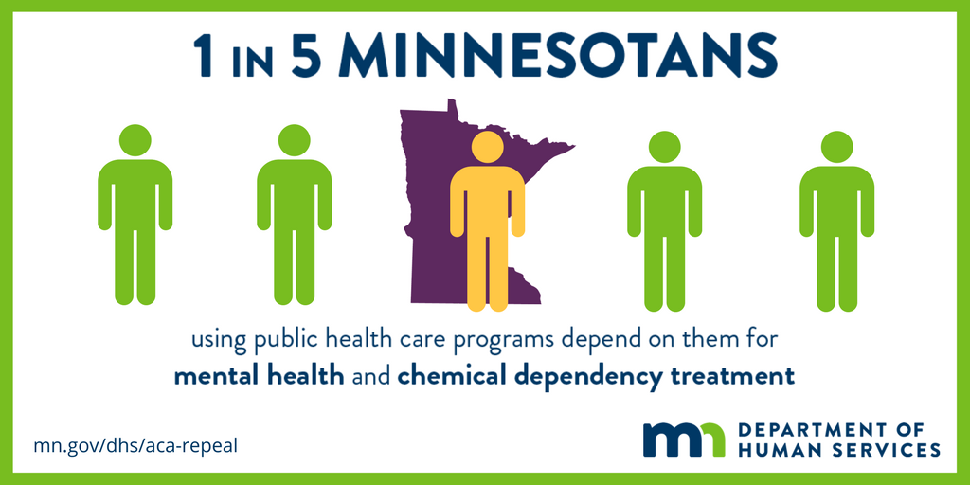
Minnesota health care programs serve …
1.2 million enrollees
$12.1 billion annual expenditures approx. (FY17)
27

Slide 28

How Minnesota has purchased health care for enrollees
Fee for service (25%)
Managed care organizations (75%)
DHS processes claims and pays providers directly
DHS pays managed care organizations (MCOs) to provide benefits to enrollees. MCOs process claims and pay providers.
28

Slide 29
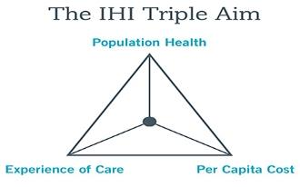
Where the IHP program comes in…
MN’s Medicaid Accountable Care Organization (ACO) model
Enhance accountability for patients’ care, create incentives for innovative care models that meet IHI triple aim
First six (6) IHPs started in 2013, covering ~100,000 Medicaid beneficiaries
We now have 25 IHPs, covering about 460,000 beneficiaries, with wide diversity and spread
In 2018, we launched our “IHP 2.0” model
29
Notes:
Why are we doing this?
Changing the conversations we usually have… Right kind of relationships and conversations with the providers and other organizations.

Slide 30

Core concepts and accountability
Medical Assistance and MinnesotaCare; fee for service and managed care
Primary care centric, but with built-in flexibility
IHP system is responsible for:
  Defined core set of health care services for an identified population (retrospective)
  Potential total cost of care shared risk (savings and losses)
  Robust quality metrics: clinical, utilization and health equity
DHS acts as facilitative partner, providing detailed data analytics, reports, ad hoc support
30
Notes:
Core of the program since the beginning -
Wide population across Medicaid
Primary care centric
Risk arrangements and quality metrics – initially limited to medical/clinical
Flexibility in how
The importance of our role as a partner with the IHPs

Slide 31
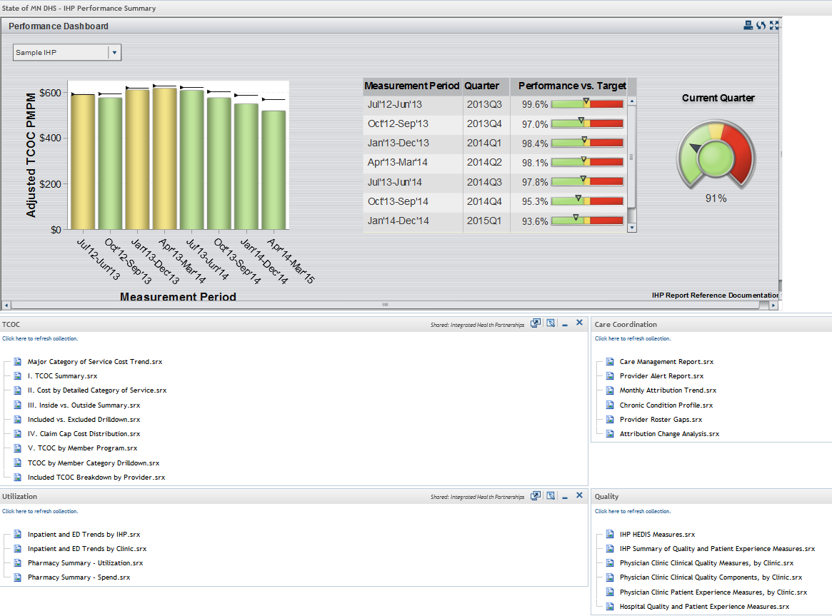
Data analytics support to help IHP’s succeed
IHPs receive a wealth of data on their attributed populations
Data includes various reports produced by DHS, as well as ‘raw’ claims and demographic data
Allows IHPs to gain a broader picture of both individual patients and overall attributed population beyond what medical records alone would allow
DHS analysts and policy team is also available to provide ad hoc support
31
Notes:
wealth of data
Various reports, as well as ‘raw’ claims and demographic data
Allows IHPs to gain a broader picture of both individual patients and overall attributed population beyond what medical records alone would allow
DHS analysts and policy team is also available to provide ad hoc support
EAS as well!

Slide 32
Example - IHP portal drilldown reports
32
Notes:
Data Files
Monthly Demographic File
Monthly Inpatient, Outpatient/Professional, Pharmacy Files
Provide 15 months of claims history
Enhanced CMR file available
Care Management Report
Based on Johns Hopkins ACG Comprehensive Patient Clinical Profile Report
Contains basic recipient demographic info, info on resource use, total cost, various summarized count (chronic conditions, inpatient visits, ED visits, etc.), risk scores, chronic condition flags
Examples:
Identify individuals with high utilization to target care coordination efforts
Identify individuals with chronic conditions in order to develop patient registries for care coordination or other outreach
Identify individuals who are homeless to connect them with housing or other social services
Provider Alert Report
Provides information on attributed members for whom a claim was submitted in the past month for an ED visit or hospital admission

Slide 33
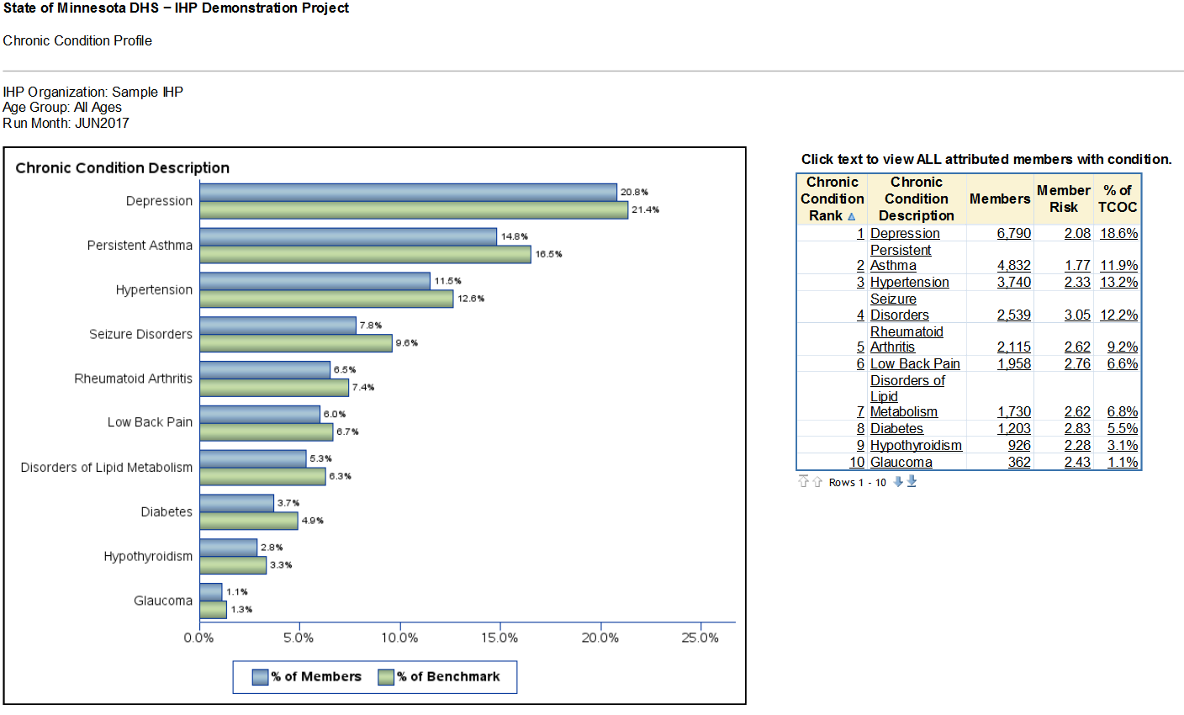
Example – Chronic condition profile
33

Slide 34
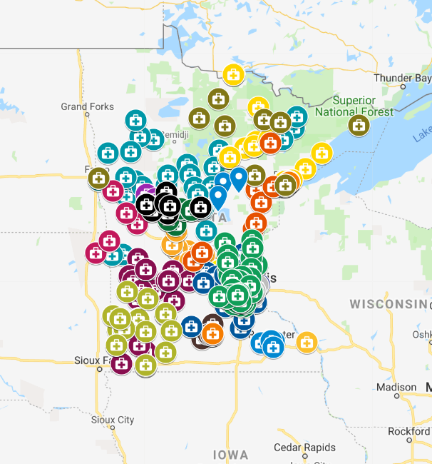
IHPs across Minnesota
    - 47% of enrollees in Greater Minnesota
    - More than 500 different provider locations
    - More than 10,000 individual practitioners
34

Slide 35
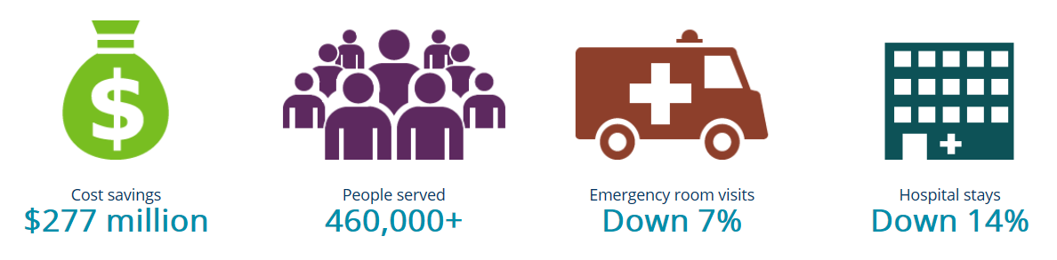
The current impact of IHPs
$401 million
(2013 – 2018)
35
Notes:
Health care providers work together across service settings to meet patient needs.
These providers share in savings they help create and in losses when goals are not met.
They look for innovations to improve the health of their communities.
This builds on Minnesota’s commitment to pay for value and good health outcomes instead of the number of visits or procedures people receive.

Slide 36
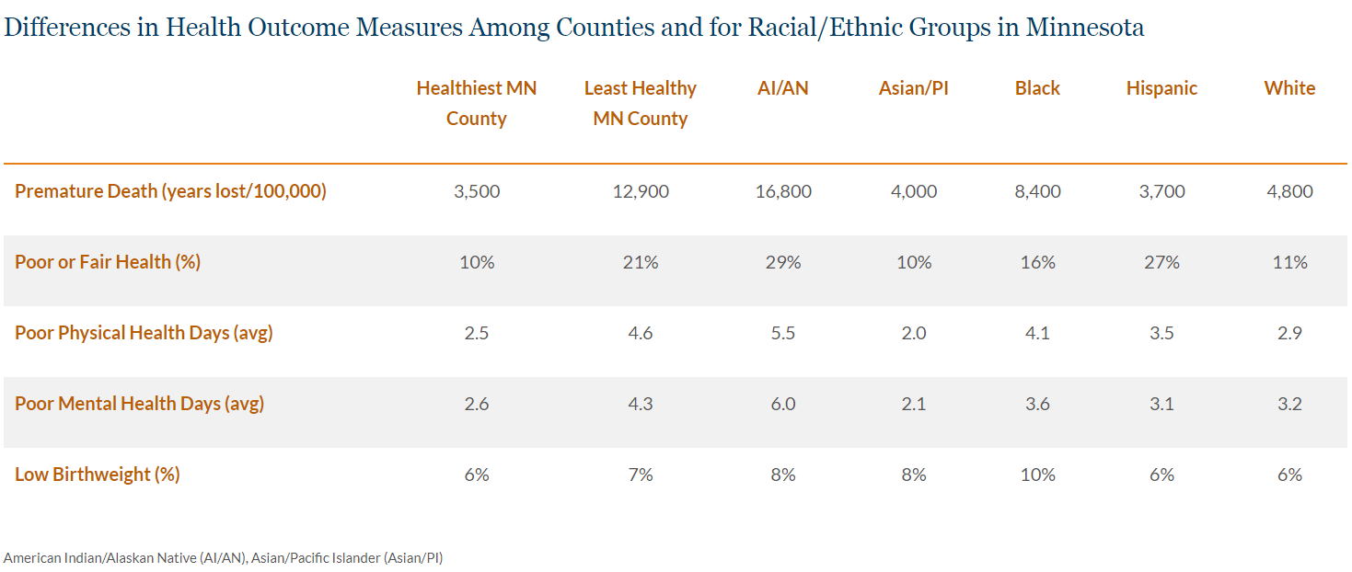
Unfortunately, we still have unmet needs -
Health disparities across Minnesota
Source: 2018 Minnesota State Report. County Health Rankings & Roadmaps.
http://www.countyhealthrankings.org/explore-health-rankings/reports/state-reports/2018/minnesota
Accessed February 28, 2019.
36
Notes:
Through a number of reports, conversations with stakeholders and participating providers, we were able to identify some areas that we needed to improve the program.
One big area, relevant to this discussion, was that we needed to include a more overt focus on disparities and social determinants within the program. Many IHPs highlighted that they felt very comfortable with modifying workflows and coordinating care within the clinic walls, but that the factors impacting Minnesotans outside of the clinic were where the real change was needed.
While MN is a pretty healthy state overall on any number of metrics, we see a very large disparity between urban and rural populations, across various counties, and between communities of color and white populations.

Slide 37
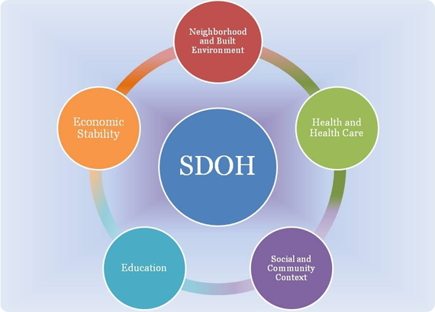
IHP recent enhancements
Population-based payment to support innovate care delivery, care coordination and infrastructure
Multiple opportunities for a wide variety of provider participants
Enhanced focus on social determinants of health and meaningful partnerships
Updates to quality metrics
Accountable Care Partnerships for enhanced risk arrangements
Enhanced data availability and timeliness
Source: www.healthypeople.gov
37
Notes:
-- With the 2.0 model, we established that in order to gain potential upside or shared savings, a system had to be willing to take on potential downside risk. SO, in the 2.0 model, we have two basic track options
-- Track 1 has no shared risk – no potential for shared gains or losses. Track 1 participants include smaller provider groups or independent practices that couldn't previously join IHP due to low attribution, and collaborative systems that aren’t sufficiently capitalized to take on downside risk.
-- Track 2 IHPs have shared risk, with the standard risk being reciprocal or equal upside vs. downside. We also built into Track 2 an incentive to partner with community-based organizations (Accountable Care Partnerships)
-- Both Track 1 and 2 get the benefit of a new payment type added to the IHP model – the Population-based payment – in essence, it can be thought of as a combination of pre-paid savings and primary care medical home care coordination-types of payments. The mean payment is around $4.50 PMPM, paid on a quarterly basis. The payment is tied to specific quality metrics, including health equity metrics. Additionally, the PBP payment amount is directly tied to an IHP population's clinical and social risk.
-- In building the 2.0 model, we wanted to overtly take steps towards better sustainability of innovations, interventions, and partnerships that crept outside of the standard medical model.
-- Accountable Care Partnerships
So, back to the “Accountable Care Partnerships” concept
Track 2 IHPs may be eligible for greater upside gain vs. downside loss potential, if they partner with community, mental health or social service partners
Ongoing legal relationship to provide services to address a population health goal; partnerships to be evaluated on:
Substantiveness of the community partnership
Sustainability of partnership and partner’s service delivery model
Impact of the community partnership on the beneficiaries’ health and experience, overall total cost and/or quality of care
These arrangements, which can result in a Track 2 IHP receiving beneficial risk terms, must include an ongoing legal relationship – basically a contract, MOU, or other written agreement.
A pure referral arrangement with no additional terms would not be sufficient.
Some examples, certainly not exhaustive, of areas in which IHPs could pursue community partnerships includes - housing, food security, social services, education, public health, comprehensive behavioral health, or transportation
We anticipate that these arrangements may be fairly idiosyncratic in nature – therefore, we will need to evaluate them on an individual basis.
If you have questions on whether a potential partnership would be sufficient, I encourage you to contact us to discuss
An important note – tack 1 IHPs may participate in an Accountable Care Partnership with a Track 2 IHP.

Slide 38

Evolution and enhancements?
38
Notes:
Risk adjustment enhancements, particularly on pediatric populations
Social risk – integrating more information (geo, care intensity, language, other factors?), enhancing our methods for capturing and modifying risk…
Strengthening partnerships – tweaking incentives? Facilitating information exchange
Evaluating partnerships and outcomes of partnerships
Evaluating the PBP
Continuing to move towards outcomes-based purchasing – Next Gen IHP model… in 2021

Slide 39
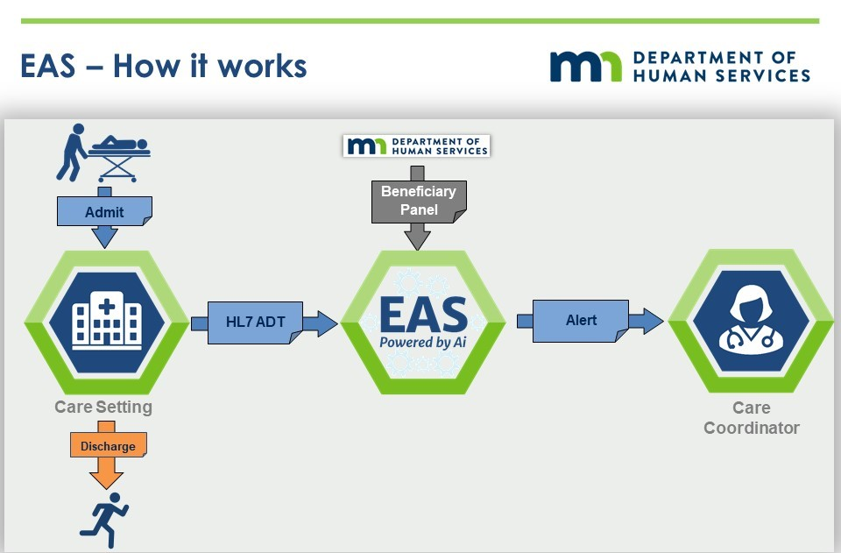
Encounter Alert Service - more timely information
39
Notes:
Real-time alert service that allows providers to see where their members are receiving care when they go outside of their system
Alerts for Admissions/Discharges/Transfers from facilities (focus on inpatient and ED)
Better transitional care management and improved outcomes for patients – potential to reduce readmissions and TCOC

Slide 40

Development of the “Next Generation” of IHP
Align financial and care delivery model to improve enrollees’ experience
A partial capitation payment to increase financial accountability, flexibility and innovation
Simplify administrative and financial functions
40
Notes:
Heather
In November 2017, DHS issued request for comment on Next Generation reforms building on past feedback with the following objectives in mind:
Focus on enrollees and outcomes
Place value on coordination of care and services that produce better health outcomes at a reasonable cost
Create more provider accountability for cost and quality
Increase financial accountability over time with a proportional level of risk
Simplify administrative and financial functions
Reinvest in enrollees, create savings for entities and taxpayers
As part of a partial capitation payment, the Next Generation IHPs will be responsible for medical management & care coordination, including:
Coordination and management of primary & specialty care
Population health programs
Identification of high risk populations
Discharge planning
Coordination of benefits
Changing finance and experience for people. Still developing. Lot of feedback. Working on modeling.

Slide 41
Mathew Spaan
Manager, Care Delivery & Payment Reform
mathew.spaan@state.mn.us
41
Notes:
Partnering with county service agencies and community organizations to target wellness resources. – A good example of this is Lakewood Health, which has an incredible program aimed at address food insecurity – they have few resources to pull from both in their community and internally as a small/lean organization. They have a team of two people who have led the work and have both a place-based intervention for low-income individuals living in senior housing and an onsite intervention that is medically tailored along with a clinic screening and additional intervention (like diabetes education or social services connections). They deliver food, connect individuals to additional services and have a “store” on site. They work with local growers and other organizations together to create a system that works.

Slide 42
Polling Question #2
Which challenge related to VBP is of most concern to your organization? (Select all the apply.)
Data quality and uniformity
Interoperability
Quality measurement
Provider attribution
Patient risk stratification
42

Slide 43
Audience Q&A
Please submit your questions
Enter your question into the “Questions” pane in the lower right hand corner of your screen.
You can also submit questions at any time to CORE@caqh.org
  The slides and webinar recording will be emailed to attendees and registrants in the next 1-2 business days.

Slide 44
Upcoming CAQH CORE Education Sessions
CORE Certification Webinar Series: Security Health Plan Demonstrates Commitment to Administrative Efficiency
Thursday, June 20, 2:00 – 3:00 PM
CMS, WEDI and CAQH CORE Webinar Series: Part 1 - CMS Complaint Management Reports
WEDNESDAY, JUNE 26, 2019 | 2:00 - 3:00 PM ET
CORE Attachments Webinar Series: Defining a Path to Electronic Exchange of Medical Documentation
WEDNESDAY, JULY 10, 2:00 – 3:00 PM
CMS, WEDI and CAQH CORE Webinar Series: Part 2- CMS Compliance Reviews
THURSDAY, JULY 18, 2019 | 2:00 - 3:00 PM ET
Conferences
HFMA 2019 Annual Conference
June 23-26, 2019

Slide 45

Thank you for joining us!
@CAQH
Website: www.CAQH.org/CORE
Email: CORE@CAQH.org
The CAQH CORE Mission
Drive the creation and adoption of healthcare operating rules that support standards, accelerate interoperability and align administrative and clinical activities among providers, payers and consumers.

